Slide 1

Objects? No Thanks!
Using C++ effectively on small microcontrollers
Wouter van Ooijen MSc (ir)
Hogeschool Utrecht, Netherlands,
senior lecturer Computer Engineering
wouter.vanooijen@hu.nl
Meeting C++ Berlin 2014, adapted for Meetup C++ 2015

Slide 2

Meeting C++ 2014 Berlin
~ 330 attendees (incl. 50 students)
2 keynotes, 20 other speakers

Slide 3
Meeting C++ 2015 Berlin
I’ll do:
Pre-conference workshop day
December 3th
Introduction 90 min
Hands-on 90 min (Arduino hardware, bare metal)
Talk “C++ on small micro-controllers”
December 4th, 60 min
I’ll miss Sinterklaas again ☹

Slide 4

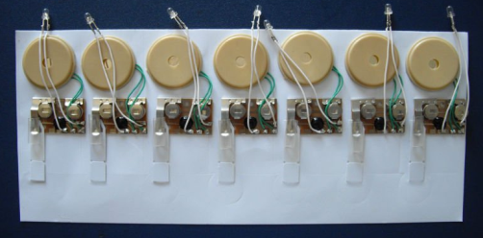

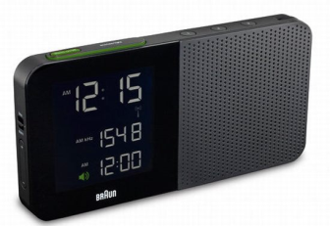
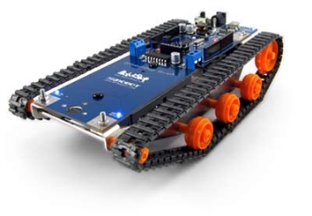

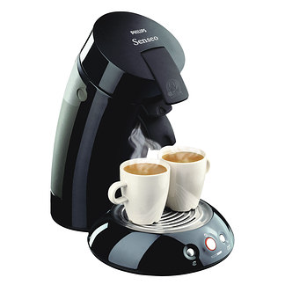


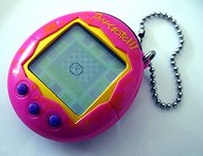
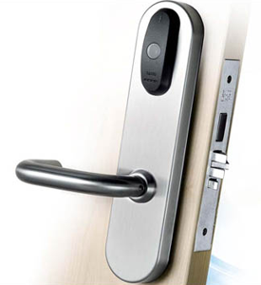
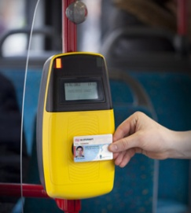
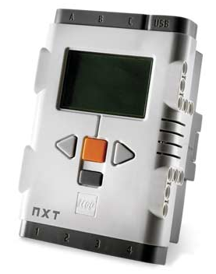
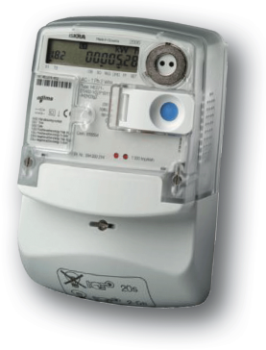
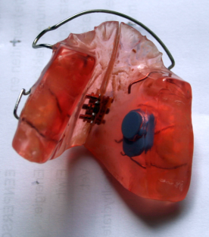
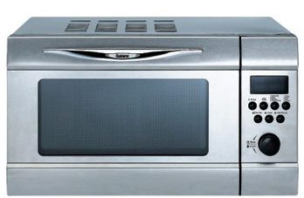




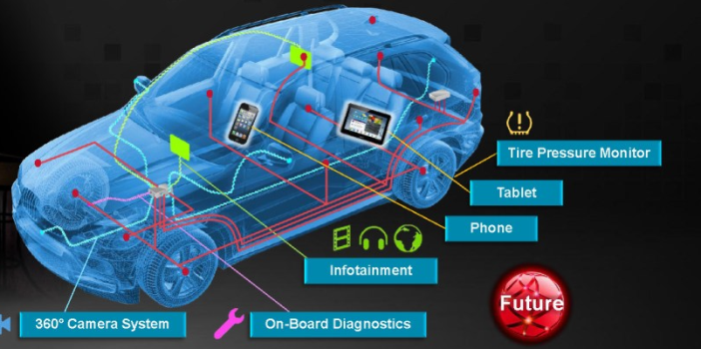
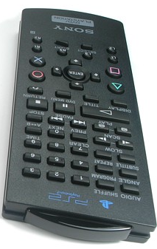



Micro-controllers are everywhere

Slide 5
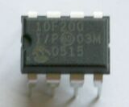
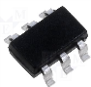
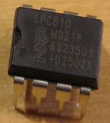
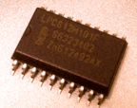
Some (very) small micro-controllers
PIC12F200
8-bit CPU
256 Flash
16 RAM
€ 0.28@100
As yet no C++ compiler*:
8-bits
crazy CPU architecture
LPC810
32-bit CPU
8k Flash
2k RAM
€ 0.67@100
A low-end chip for C++:
32 bits
Cortex-M0+
GCC
* There are 8-bit CPUs that do support C++.

Slide 6
Small microcontroller economics
Product cost scales with use of resources:
CPU speed (power consumption!!)
code size (Flash)
data size (RAM)
Those prices are payed by the manufacturer, not by the end user (as for desktop software).
➔ Pressure on the developers to reduce resource use: every data byte or instruction counts (even if only in the perception of the managers).

Slide 7
Typical small micro-controller programming
Applications are small
Volumes are high
Worst-case timing constraints must be met (average timing is not important)
C dominates (even assembler is still used)

Slide 8
Code re-use
Is hindered by
Small size, so (perceived) benefit is small
Code is often written by electrical engineers
Lack of abstraction mechanisms in C
Each application has unique aspects, down to the lowest levels

Slide 9
So why should C++ be used?
As a better C
(same programming style, less room for errors)
Enables other programming styles
(OO, functional, templates, . . .)
More opportunities for (efficient) code re-use

Slide 10
C++, but not like on a desktop
Heap: forget it
(if needed: per-size pools)
Floating point: often not practical
(no HW FPU, SW FP library is large and slow)
Exceptions: debatable
(but practical problems)
C++ standard library: large parts are unusable
(heap, float/double, worst-case performance)
OO at run-time: often not needed

Slide 11
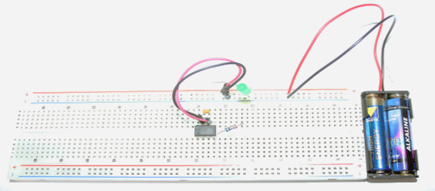
Test case: blink a LED
The embedded equivalent of ”Hello world”
Using an LPC1114 chip (Cortex-M0 CPU).

Slide 12
Blink a LED in C
// return the pointer to an IO port related register
#define GPIOREG( port, offset ) \
(*(volatile int *)( 0x50000000 + (port) * 0x10000 + (offset)))
// set the gpio pin ‘port.pin’ to value
#define PIN_SET( port, pin, value ) \
{ GPIOREG( (port), 0x04 << (pin) ) = (value) ? -1 : 0; }
int main(){
for(;;){
PIN_SET( 1, 0, 1 );
delay();
PIN_SET( 1, 0, 0 );
delay();
}
}
.L97:
ldr r4, .L98 // get the I/O register address
mov r3, #1 // get -1 into r3
neg r0, r3
str r0, [r4] // store -1 in the I/O register
bl delay
mov r1, #0
str r1, [r4] // store 0 in the I/O register
bl delay
b .L97
.align 2
.L98:
.word 1074036740
Some ugly details (initialization, timing, …) have been omitted to concentrate on making the pin high and low.

Slide 13
PIN_SET( 1, 0, 1 )
// set the pin port.pin to value
#define PIN_SET( port, pin, value ) \
{ GPIOREG( (port), 0x04 << (pin) ) = (value) ? -1 : 0; }
Abstraction of an I/O pin
+ Efficient
- It is a macro! (scope, textual parameters, … )
- Can’t easily be replaced or augmented by the user
- not easy to separate what from how

Slide 14
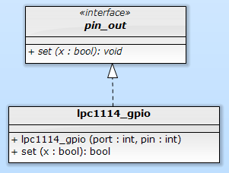
Classic OO pin abstraction
struct pin_out {
virtual void set( bool ) = 0;
};
volatile int & gpioreg( int port, int offset ){
return * (volatile int *) ( 0x50000000 + port * 0x10000 + offset );
}
struct lpc1114_gpio : public pin_out {
const int port, pin;
lpc1114_gpio( int port, int pin )
: port{ port }, pin{ pin }{}
void set( bool x ) override {
gpioreg( port, 0x04 << pin ) = x ? -1 : 0;
}
};
void blink( pin_out & pin ){
for(;;){
pin.set( 1 );
delay();
pin.set( 0 );
delay();
}
}
int main(){
lpc1114_gpio led( 1, 0 );
blink( led );
}
Abstract class with virtual functions

Slide 15
Metrics
for set(1) + set(0) + ‘support’ code
PIN_SET( 1, 0, 1 );
PIN_SET( 1, 0, 0 );
pin.set( 1 );
pin.set( 0 );
 | C (macro) | C++ (virtual functions)
Code (bytes Flash) | 16 | 68
RAM | 0 | 12
CPU cycles | ~ 9 | ~ 56
☹
What has gone wrong?

Slide 16
Generated code (C++ OO-style)
void blink( pin_out & pin ){
for(;;){
pin.set( 1 );
delay();
pin.set( 0 );
delay();
}
}
int main(){
lpc1114_gpio led( 1, 0 );
blink( led );
}
push {r4, lr}
mov r4, r0
.L12:
ldr r3, [r4]
mov r0, r4
ldr r3, [r3]
mov r1, #1
blx r3
bl _Z5delayv
ldr r3, [r4]
mov r0, r4
ldr r3, [r3]
mov r1, #0
blx r3
bl _Z5delayv
b .L12
24
_ZN12lpc1114_gpio3setEb:
ldr r3, [r0, #4]
push {r4, lr}
mov r4, #160
lsl r4, r4, #7
add r2, r3, r4
ldr r3, [r0, #8]
mov r0, #4
lsl r2, r2, #16
lsl r0, r0, r3
add r3, r2, r0
neg r1, r1
str r1, [r3]
pop {r4, pc}
ldr r3, .L14
add r0, sp, #4
str r3, [sp, #4]
mov r3, #1
str r3, [sp, #8]
mov r3, #0
str r3, [sp, #12]
bl _Z5blinkR7pin_out
.align 2
.L14:
.word 1342177284
18
26

Slide 17

Why so much code (and data)?
Run-time polymorphism:
Connection between operation and implementation is made at run time
This takes code, CPU cycles, even some RAM, and blocks optimizations
Fixed-hardware embedded systems generally don’t need such run-time flexibility, but
Efficient use of libraries does require compile-time flexibility

Slide 18
Alternative: compile-time polymorphism
Static classes (or structs) can be used as compile-time encapsulation of data and operations.
Template parameters can be used to pass such an encapsulation to another one.
These are compile-time-only actions, hence fully visible to the optimizer.

Slide 19
Run-time polymorphism
Compile-time polymorphism
struct pin_out {
virtual void set( bool ) = 0;
};
struct lpc1114_gpio : public pin_out {
lpc1114_gpio( . . . ) . . .
void set( bool x ) override { . . . }
};
struct blink {
pin_out & pin;
blink( pin_out & pin ): pin( pin ){}
void run(){
. . .
pin.set( 1 );
}
}
int main(){
blink( lpc1114_gpio( 1, 2 )).run();
}
struct pin_out_archetype {
typedef void has_pin_out;
static void set( bool value ){}
}
template< int port, int pin >
struct lpc1114_gpio : public pin_out_archetype {
static void set( bool value ){ . . . }
};
template< typename pin >
struct blink {
void run(){
. . .
pin::set( 1 );
}
}
int main(){
blink< lpc1114_gpio< 1, 2 >>::run();
}
template< int port, int pin >
struct lpc1114_gpio {
static void set( bool value ){ . . . }
};
template< typename pin >
struct blink {
void run(){
. . .
pin::set( 1 );
}
}
int main(){
blink< lpc1114_gpio< 1, 2 >>::run();
}
As before, some ugly details (initialization, timing, …) are omitted.

Slide 20
Generated code (C versus C++ C-T-P)
// C with macro’s
.L97:
ldr r4, .L98
mov r3, #1
neg r0, r3
str r0, [r4]
bl delay
mov r1, #0
str r1, [r4]
bl delay
b .L97
// C++ with compile-time polymorphism
.L3:
ldr r4, .L5+12
mov r3, #1
neg r3, r3
str r3, [r4]
ldr r0, .L5+16
bl _...waiting_324waitEj
mov r3, #0
str r3, [r4]
ldr r0, .L5+16
bl _...waiting_324waitEj
b .L3
 | C | C++
Code (bytes Flash) | 16 | 16
RAM | 0 | 0
CPU cycles | ~ 9 | ~ 9
☺

Slide 21
Blink: some (ugly?) details
#include "targets/lpc1114fn28.hpp"
typedef hwcpp::lpc1114fn28<> target;
int main(){
hwcpp::blink< target::gpio_1_2, target::waiting >::run();
}
template<
typename arg_pin,
typename arg_timing
> struct blinking {
typedef pin_out_from< arg_pin > pin;
typedef waiting_from< arg_timing > timing;
typedef typename timing::duration duration;
static void run( const duration t = duration::ms( 500 ) ){
timing::init();
pin::init();
for(;;){
pin::set( 1 );
timing::wait( t / 2 );
pin::set( 0 );
timing::wait( t / 2 );
}
}
};
#include "targets/lpc1114fn28.hpp"
typedef hwcpp::lpc1114fn28<> target;
int main(){
hwcpp::blink< target::gpio_0_0, target::waiting >::run();
}
Type narrowing
Explicit initialization

Slide 22
------- Four
Three pin archetypes
struct pin_in_archetype {
typedef void has_pin_in;
static void init();
static bool get();
};
struct pin_out_archetype {
typedef void has_pin_out;
static void init();
static void set( bool value );
};
struct pin_in_out_archetype {
typedef void has_pin_in_out;
static void init();
static void direction_set_input();
static void direction_set_output();
static bool get();
static void set( bool value );
};
struct pin_oc_archetype {
typedef void has_pin_oc;
static void init();
static bool get();
static void set( bool value );
};

Slide 23
Type narrowing
class target {
typedef . . . pin_a0;
}
typedef target::pin_a0 alarm;
int main(){
alarm::init();
alarm::direction_set_output();
alarm::set( false );
if( . . . ){
alarm::set( true );
}
}
class target {
typedef . . . pin_a0;
}
typedef pin_out_from< target::pin_a0 > alarm;
int main(){
alarm::init();
alarm::direction_set_output();
alarm::set( false );
if( . . . ){
alarm::set( true );
}
}
The template parameter is type-checked
The template adapts to the parameter type
Initialization is ‘complete’
The code can’t accidentally use an inappropriate method

Slide 24
pin_out_from< . . . > template
template< class unsupported, class dummy = void > struct pin_out_from {
static_assert( sizeof( unsupported ) == 0, . . . ); };
template< class pin > struct pin_out_from < pin, typename pin::has_pin_out > :
public pin_out_archetype
{
static void init(){ pin::init(); }
static void set( bool value ){ pin::set( value ); }
};
template< class pin > struct pin_out_from < pin, typename pin::has_pin_oc > :
public pin_out_archetype
{
static void init(){ pin::init(); }
static void set( bool value ){ pin::set( value ); }
};
template< class pin > struct pin_out_from < pin, typename pin::has_pin_in_out > :
public pin_out_archetype
{
static void init(){ pin::init(); pin::direction_set_output(); }
static void set( bool value ){ pin::set( value ); }
};
template< class unsupported, class dummy = void > struct pin_out_from {
static_assert( sizeof( unsupported ) == 0, . . . ); };
template< class pin > struct pin_out_from < pin, typename pin::has_pin_out > :
public pin_out_archetype
{
static void init(){ pin::init(); }
static void set( bool value ){ pin::set( value ); }
};
template< class pin > struct pin_out_from < pin, typename pin::has_pin_oc > :
public pin_out_archetype
{
static void init(){ pin::init(); }
static void set( bool value ){ pin::set( value ); }
};
template< class unsupported, class dummy = void > struct pin_out_from {
static_assert( sizeof( unsupported ) == 0, . . . ); };

Slide 25

Don’t say it in a comment
invert< . . . >
decorator
namespace target {
typedef . . . pin_a0;
}
typedef target::pin_a0 alarm_led;
// the alarm LED pin is active low
constexpr bool alarm_led_active = false;
int main(){
alarm_led::set( ! alarm_led_active );
if( . . . ){
alarm_led::set( alarm_led_active );
}
}
namespace target {
typedef . . . pin_a0;
}
typedef target::pin_a0 alarm_led;
int main(){
alarm_led::set( false );
if( . . . ){
alarm_led::set( true );
}
}
Say it in the code
namespace target {
typedef . . . pin_a0;
}
typedef invert< target::pin_a0 > alarm_led;
int main(){
alarm_led::set( false );
if( . . . ){
alarm_led::set( true );
}
}

Slide 26
Pin invert< . . . > template
template< class unsupported, class dummy = void > struct invert {
static_assert( sizeof( unsupported ) == 0, ". . ." ); };
template< class pin > struct invert< pin, typename pin::has_pin_in > :
public pin_in_archetype {
static void init(){ pin::init(); }
static bool get(){ return ! pin::get(); } };
template< class pin > struct invert< pin, typename pin::has_pin_out > :
public pin_out_archetype {
static void init(){ pin::init(); }
static void set( bool x ){ pin::set( ! x ); } };
template< class pin > struct invert< pin, typename pin::has_pin_in_out > :
public pin_in_out_archetype {
static void init(){ pin::init(); }
static void direction_set_input(){ pin::direction_set_input(); }
static void direction_set_output(){ pin::direction_set_output(); }
static void set( bool x ){ pin::set( ! x ); }
static bool get(){ return ! pin::get(); } };
template< class pin > struct invert< pin, typename pin::has_pin_oc > :
public pin_oc_archetype {
static void init(){ pin::init(); }
static void set( bool x ){ pin::set( ! x ); }
static bool get(){ return ! pin::get(); } };
Often:
ZERO cost!

Slide 27
Some more pin & port decorators
// create the stated pin or port type from p
pin_in_from< p >
pin_out_from< p >
pin_in_out_from< p >
pin_oc_from< p >
port_in_from< p >
port_out_from< p >
port_in_out_from< p >
port_oc_from< p >
// create a port of the stated type from pins
port_in_from_pins< p, ... >
port_out_from_pins< p, ... >
port_in_out_from_pins< p, ... >
// invert the value read from or written to p
invert< p >
// pin or port that writes to all pins or ports
all< p, ... >

Slide 28
Using static class templates: consequences (1)
Abstraction tool is the class template with only static contents (classes, methods, attributes)
Composition is by template instantiation
Method call syntax is class::method(…) instead of object.method(…)
Header-only

Slide 29
Using static class templates: consequences (2)
No objects (of such classes) are created
No memory management, no dangling references
Sharing of identical constructs is automatic
No automatic construction: explicit init() calls
Overhead can be zero

Slide 30

Long term view
A use case
Write library code for reading the temperature from an LM75 chip (I2C interface). Write it once and for all.
What should be in this code?
Getting the data bits from the LM75 (using I2C)
Converting the data bits to a temperature
Maybe detecting errors in the data bits (passing I2C errors along?)
What should NOT be in this code?
I/O pin handling
I2C protocol
Timing
Conversion to the requested datatype (int, float, double, fixed-point, … )
Conversion to the requested unit (Kelvin, Celcius, Fahrenheit, … )
Floating point calls

Slide 31
Next steps
Combine compile-time and run-time parameterization
Identify and/or implement abstraction(s) for
Timing
Multithreading (run-to-completion?)
Values (units, fixed-point)
Error handling

Slide 32
Devirtualization?
Compilers are starting to do devirtualization (as part of whole-program optimization). How would perfect de-virtualization compare to the static-class-template approach?
Objects + ideal devirtualization | Static class templates
Run-time allocation | Compile/link time allocation
Global, stack or heap allocation | Only global allocation
Danger of dangling references | No such danger
Run-time flexibility | Requires extra effort
Sharing requires planning | Sharing is automatic (prevention is tricky)
Well-known syntax & style | Unfamiliar syntax & style

Slide 33
C++ language issues
Class templates and plain classes can’t have the same name.
The syntax for using static attributes of class templates can be horrible.
A LOT of template and typename prefixes can be required to disambiguate (template parameter-) dependent names.
C++0x11 has override for virtual methods, but there is no equivalent for static methods.

Slide 34

C++ language wish list
Allow override for static methods
Allow a static operator()
Allow template / class name overloading
Allow constexpr char * as template parameter (if possible all constexpr’s ? . . .)
Get rid of (some of) those mandatory template and typename qualifiers
PS: I will NOT donate a kidney.

Slide 35
Summary
Current C++ libraries and programming practices are often not optimal for very small systems.
Compile-time polymorphism using static class templates (no objects!)
Can be as efficient as C macro’s.
Has an abstraction power comparable in power but very different in nature to classic run-time-objects-based OO.
There is a lot of interesting work to do to create C++ libraries that help programming very small systems.

Slide 36
Passing a type – two alternatives
As type
(explicit template parameter)
template< int n, int m >class gpio { . . . };
template< typename x > class invert { . . . };
typedef gpio< 1, 2 > pin_b2;
invert< pin_b2 > led;
As type object
(explicit object parameter == implicit template parameter)
template< int n, int m >class gpio { . . . };
template< typename t > auto invert( t x ){ . . . };
gpio< 1, 2 > pin_b2;
auto led = invert( pin_b2 );

Slide 37
Avoid run-time overhead
By using templates
template< int n, int m >class gpio { . . . };
typedef gpio< 1, 2 > pin_b2;
pin_b::set();
By relying on devirtualization
class gpio { virtual void set() = 0; }
template< int n, int m > class cortex_gpio : gpio {
void set(){ . . . }
}
cortex_gpio< 1, 2 > pin_1_2;
pin_1_2::set();

Slide 38
Have your cake AND eat it with whole-program optimization
class gpio { virtual void set() = 0; }
template< int n, int m > class cortex_gpio : gpio {
void set(){ . . . }
}
cortex_gpio< 1, 2 > pin_1_2;
cortex_gpio< 1, 3 > pin_1_3;
cortex_gpio< 1, 4 > pin_1_4;
void f( gpio & p ){ p.set(); . . . }
pin_1_2.set();
f( pin_1_2 );
void g( gpio & p ){ p.set(); . . . }
g( pin_1_2 );
g( pin_1_3 );
g( pin_1_4 );
Devirtualization:
➔ inline
➔ optimization
Run-time polymorphism

